Slide 1
WELCOME

Slide 2
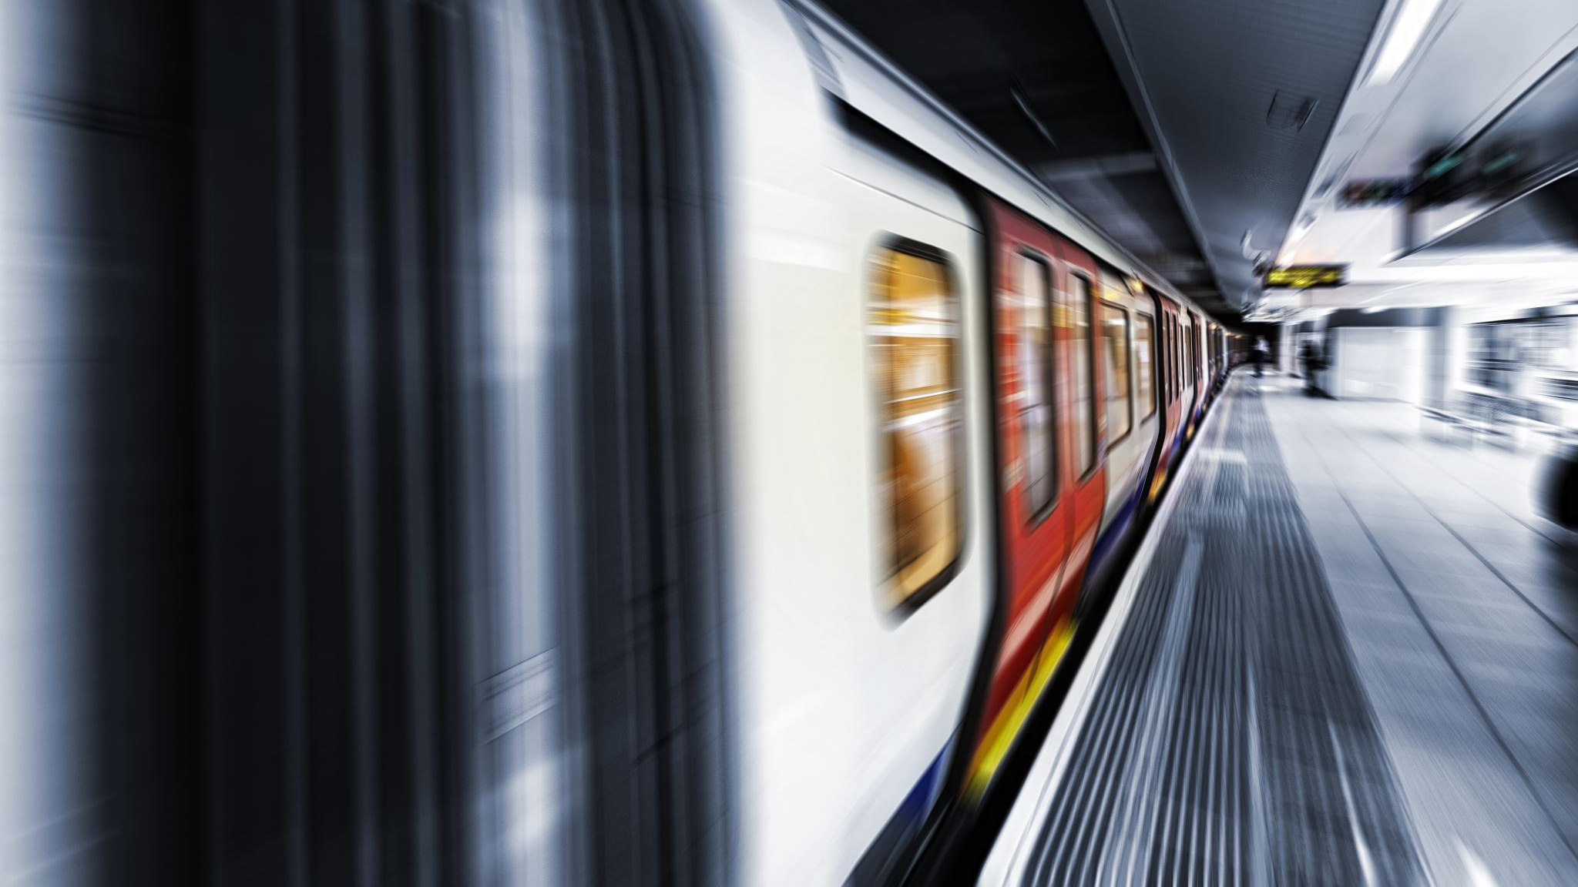
TRAIN TICKET BOOKING
Batch – 85
Team – 4
Dhamotharan
Divya
Neeraj
Padmaraju
Suvetha

Slide 3
Contents
Business Requirements
Class Design
MVC
Screenshots

Slide 4
Business Requirements
The Trains should be fetched from database using train number.
Travel date should be after current Date.
The PNR number should be auto-generated by adding first character of source station, first character of destination station, travel date(yyyymmdd) and a running counter starting from 100.
The ticket Fare for each passenger is calculated based on business requirement.
The file name for storing the generated ticket should be the PNR Number.

Slide 5
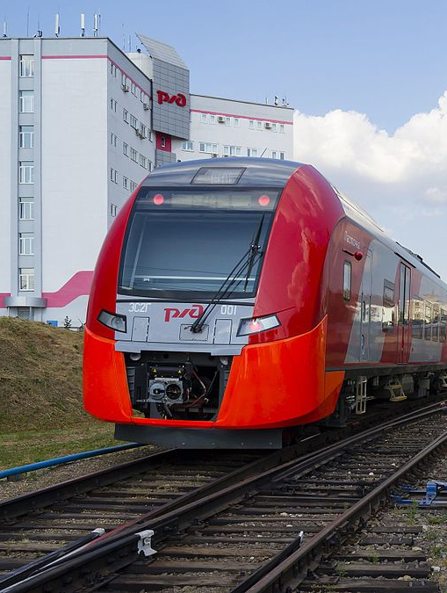
1.Train
For Booking a train ticket user should enter the train number.
using the train number provided by the user, The train details will be fetched from the database.
If the train number provided by the user is not available, it will print as "Train not found".
This Photo by Unknown author is licensed under CC BY-SA.

Slide 6
2. Passenger
In this module, the details of the passenger need to be entered to generate a ticket.
Based upon the business requirements the fare of each passenger is calculated as follows:
For age < = 12, fare is 50% of ticket price regardless of gender.
For age > = 60, fare is 60% of ticket price regardless of gender.
For Females, 25% discount on the ticket price

Slide 7
3. Ticket
Generate PNR method :
This method builds the PNR as per the business rules and returns the generated PNR.
Add passenger method :
AddPassenger method take passenger details as parameters, creates passenger object and adds the passenger as a key and the calculated passenger fare as the value in TreeMap ‘passengers’.
CalculateTotalTicketPrice() method :
This method returns the total ticket price based on business rules.

Slide 8
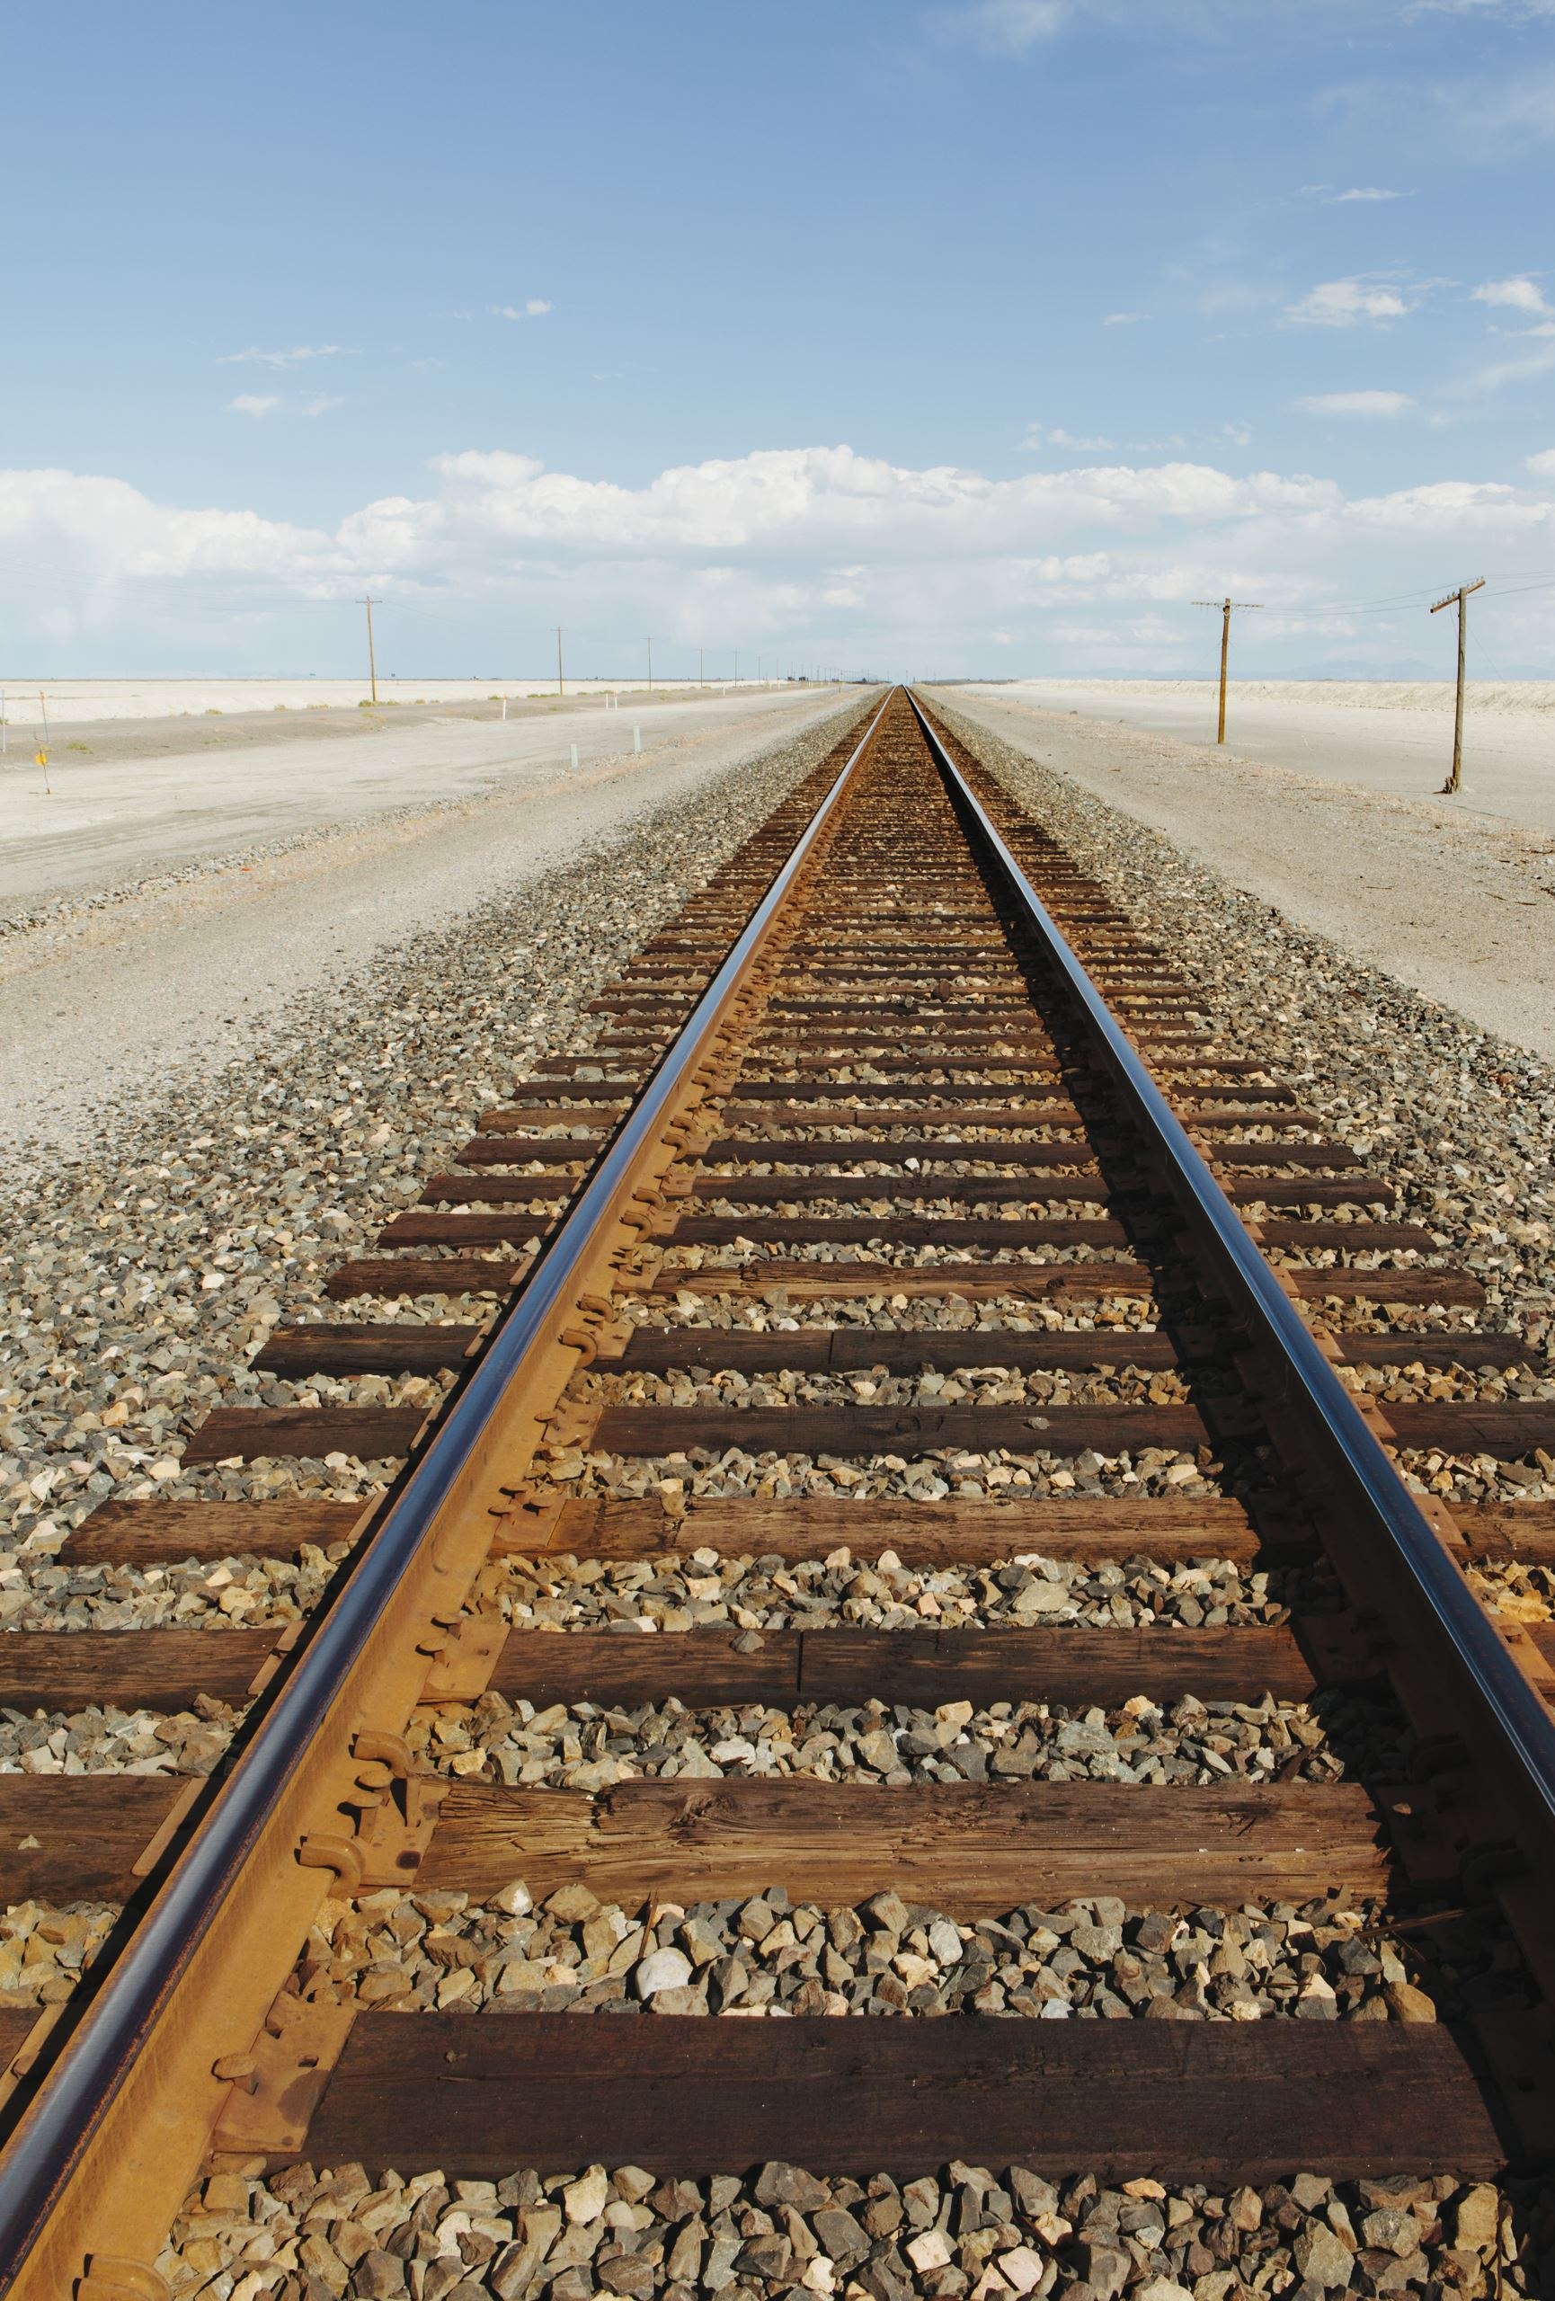
4. Train DAO
find train number method takes train number as a input and returns the train details.
5. Ticket Application
Contains a main method and is the starting point of Application.
It gets the information like train number, travel date, number of passengers using a scanner.
Then by using the TRAIN DAO it displays ticket details.

Slide 9
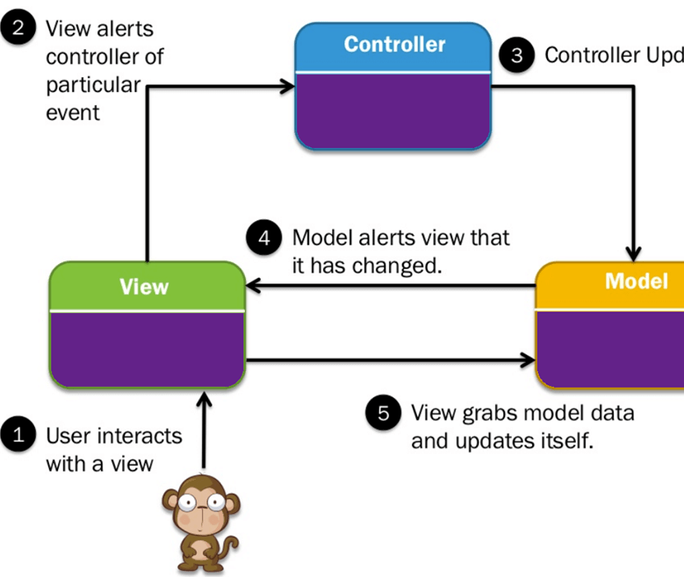
(MVC) Model-View-Controller

Slide 10
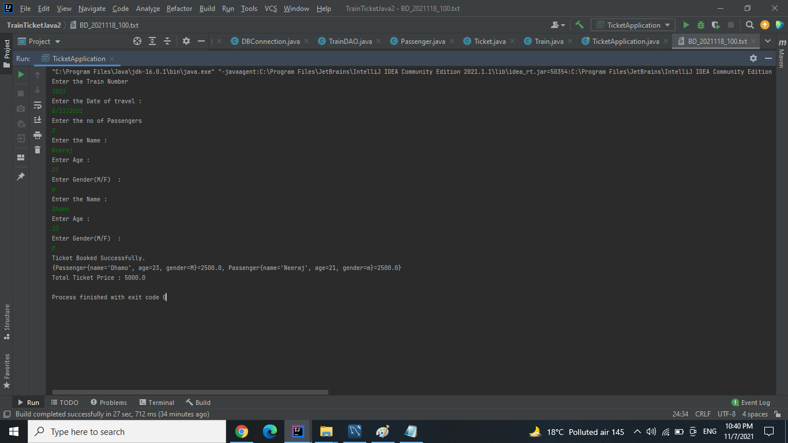

Slide 11
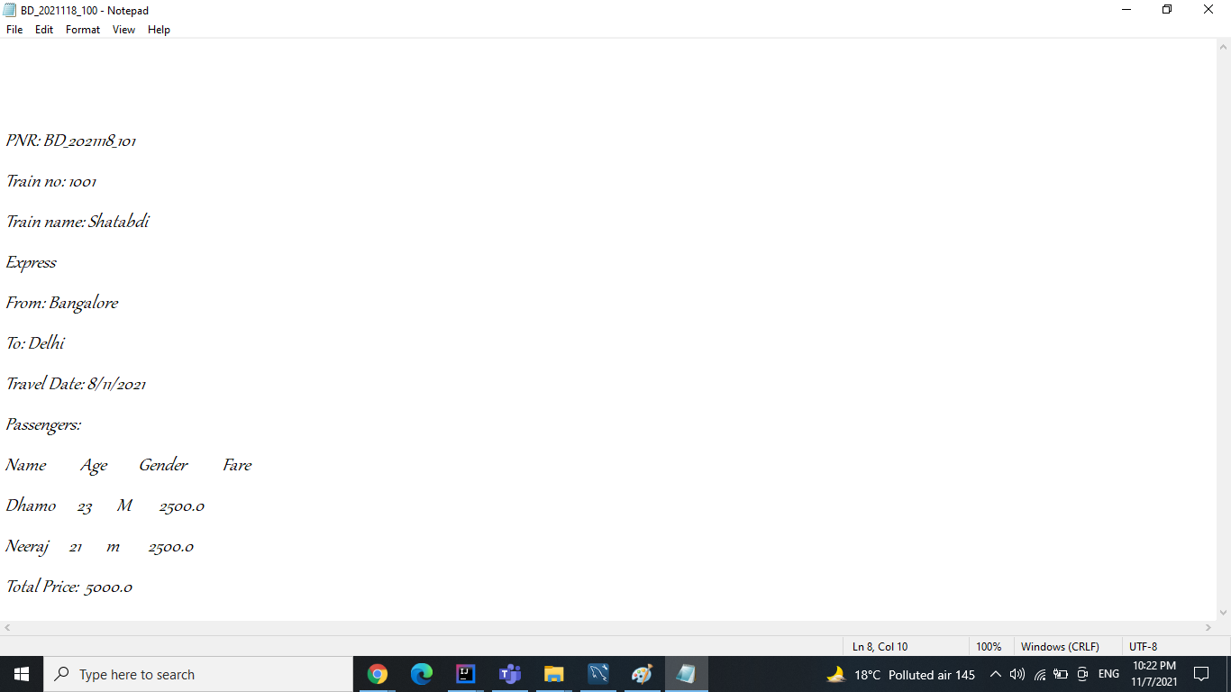

Slide 12
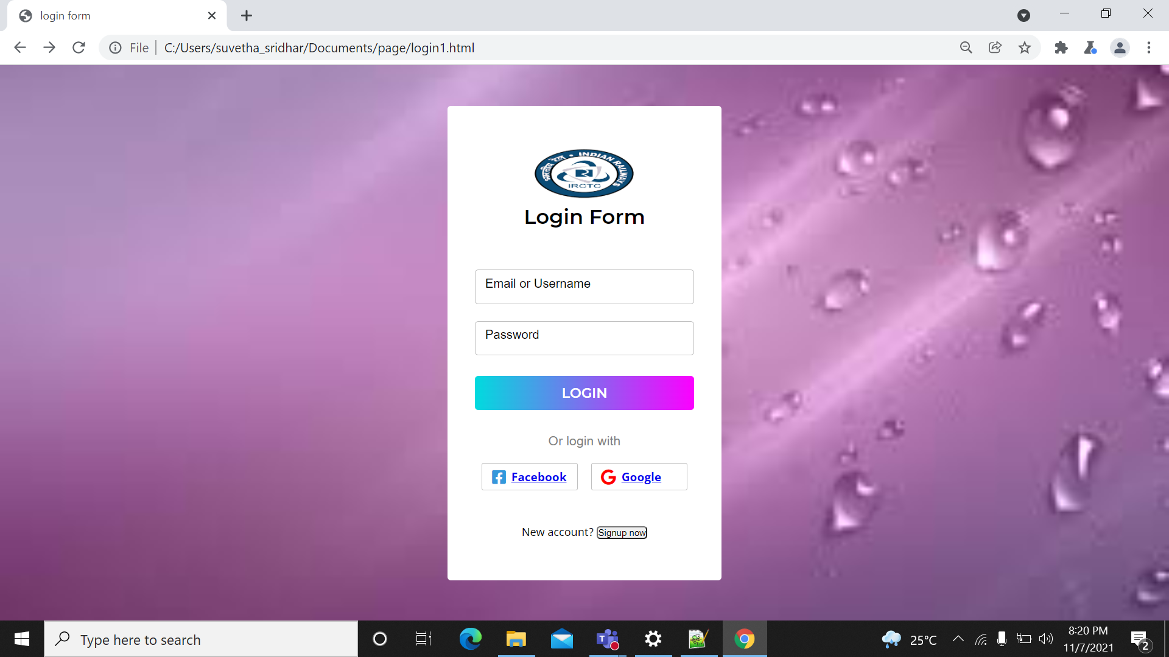
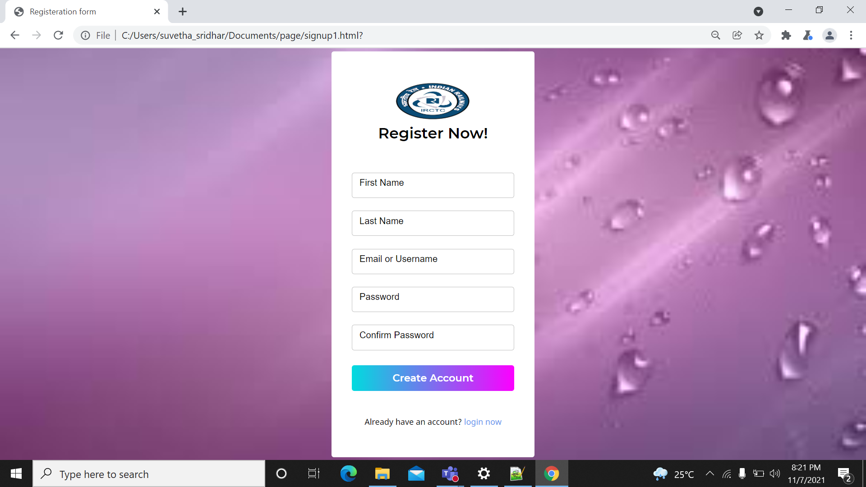
Web pages

Slide 13
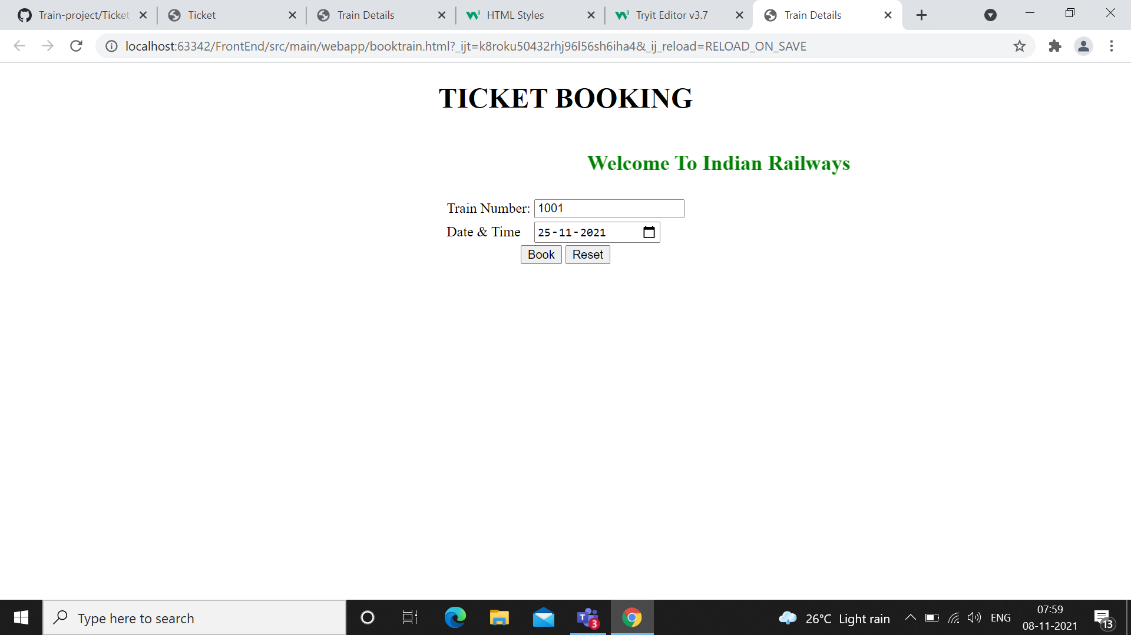
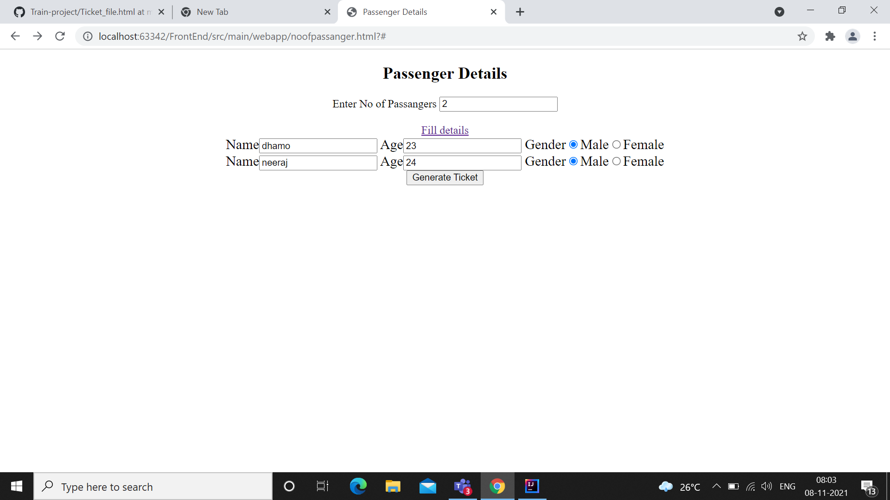

Slide 14
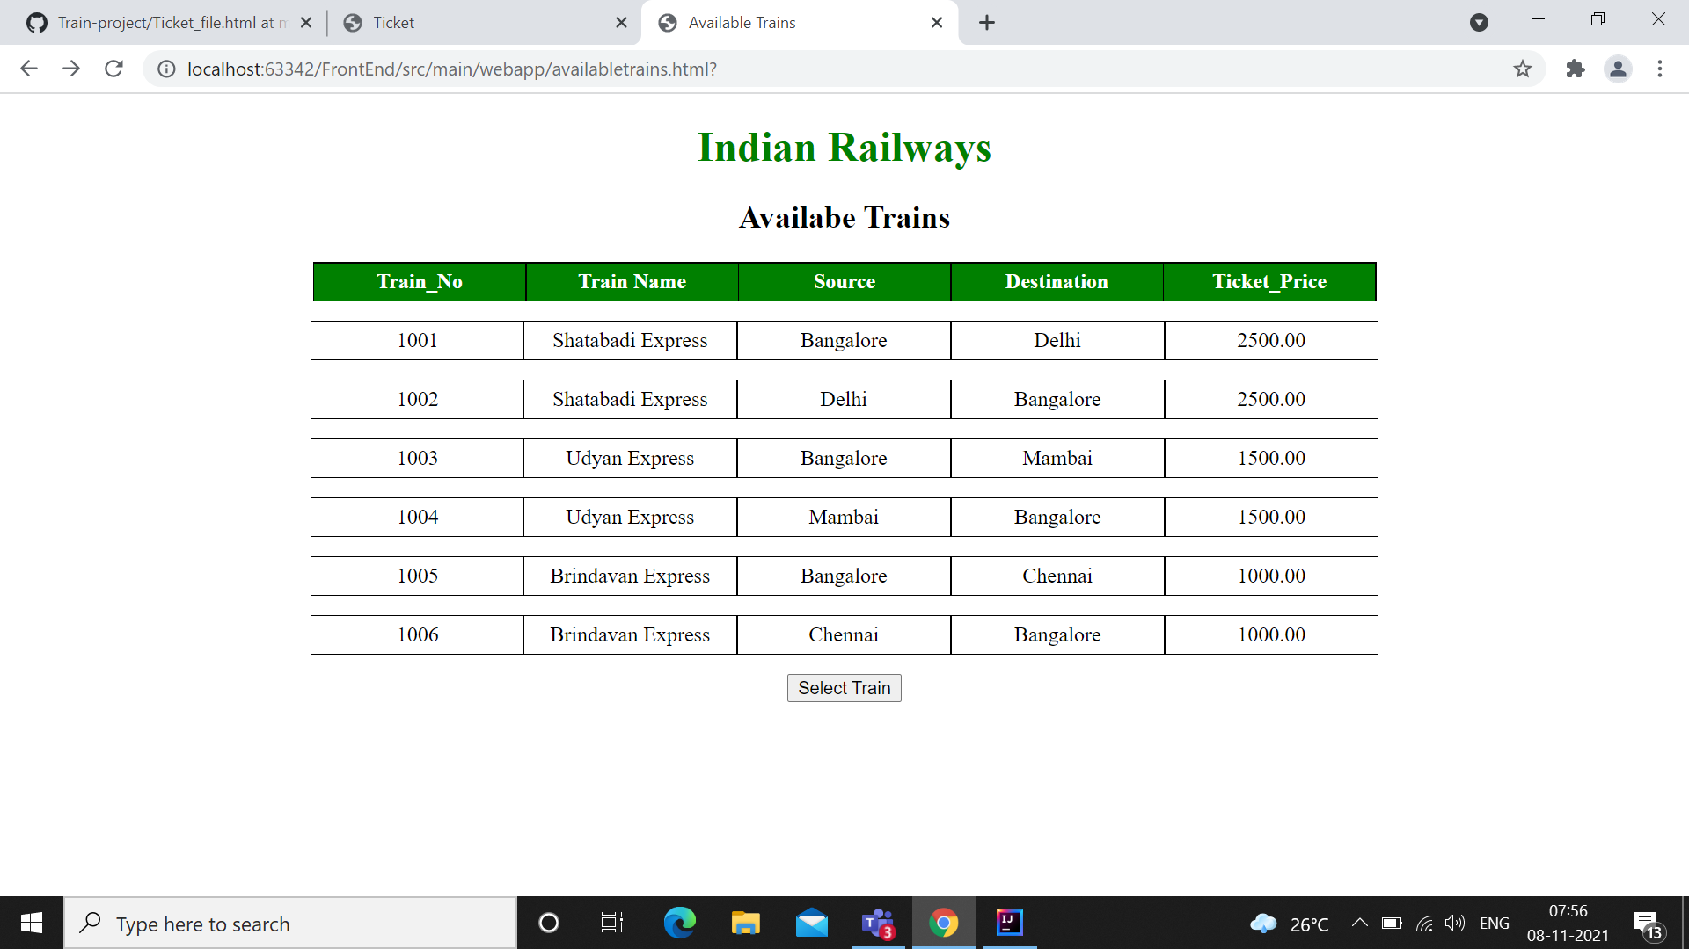
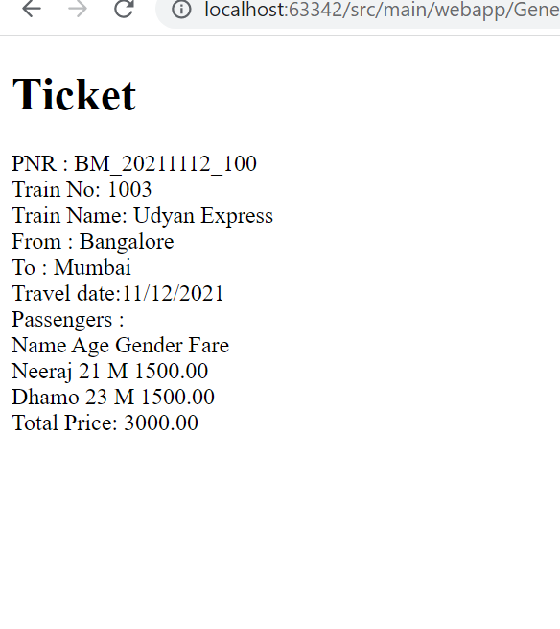

Slide 15
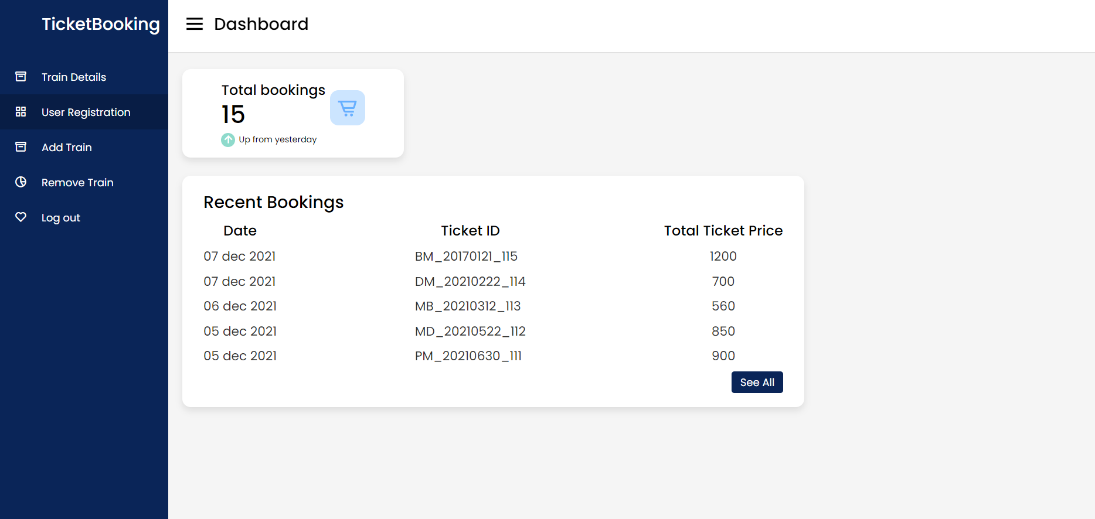
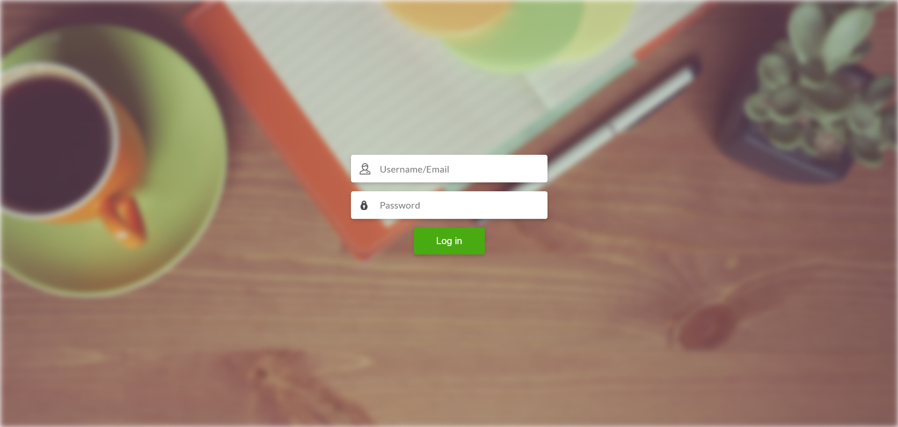

Slide 16
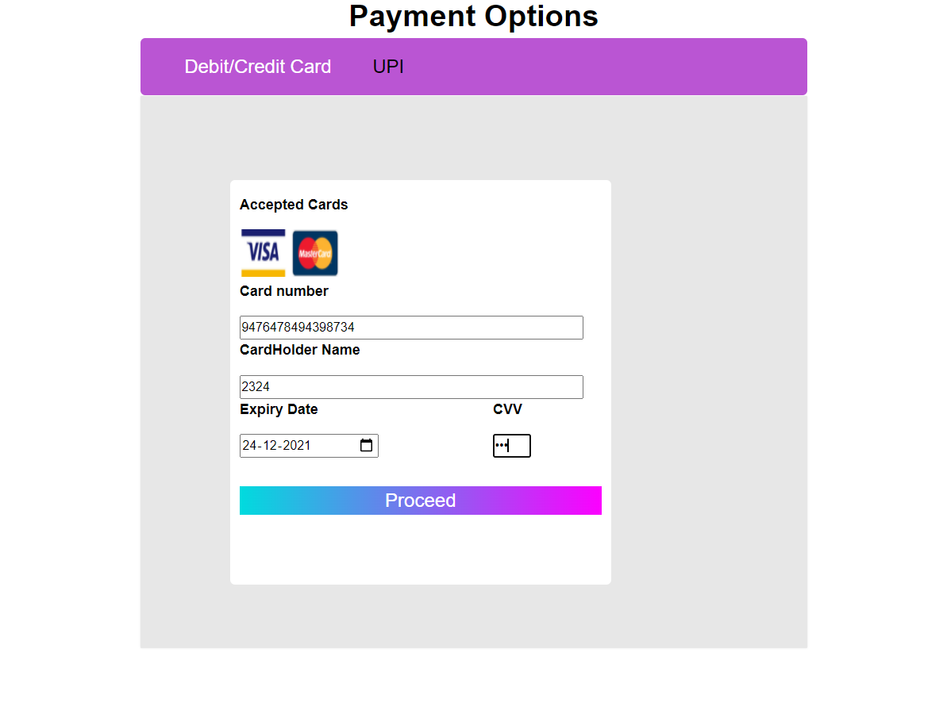
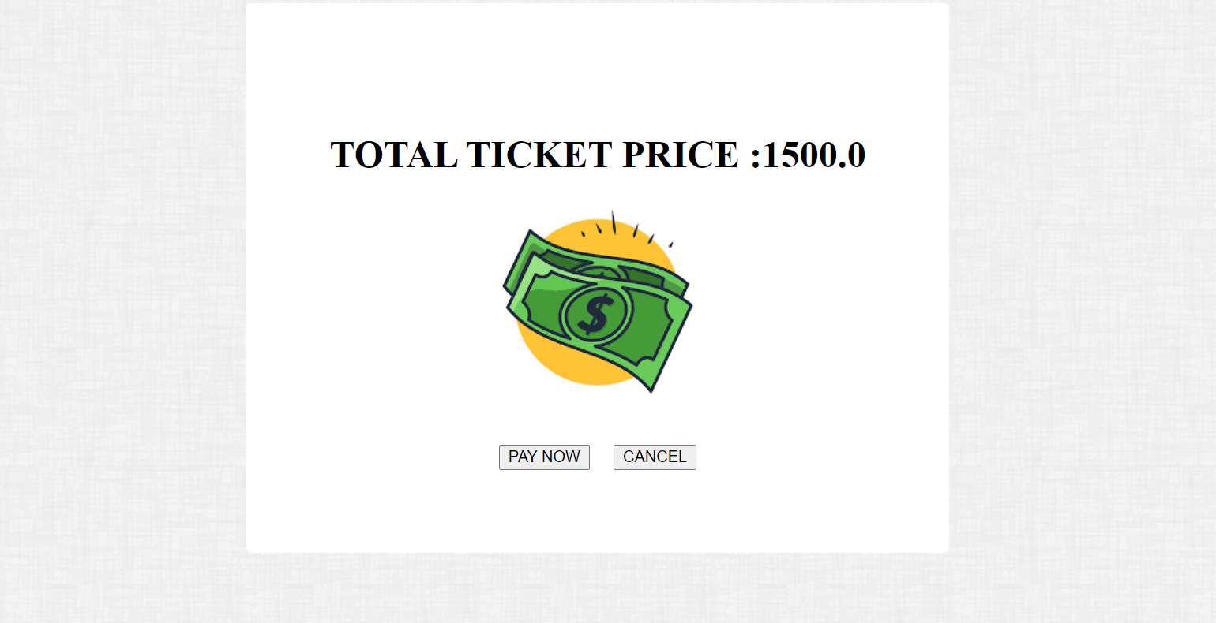

Slide 17
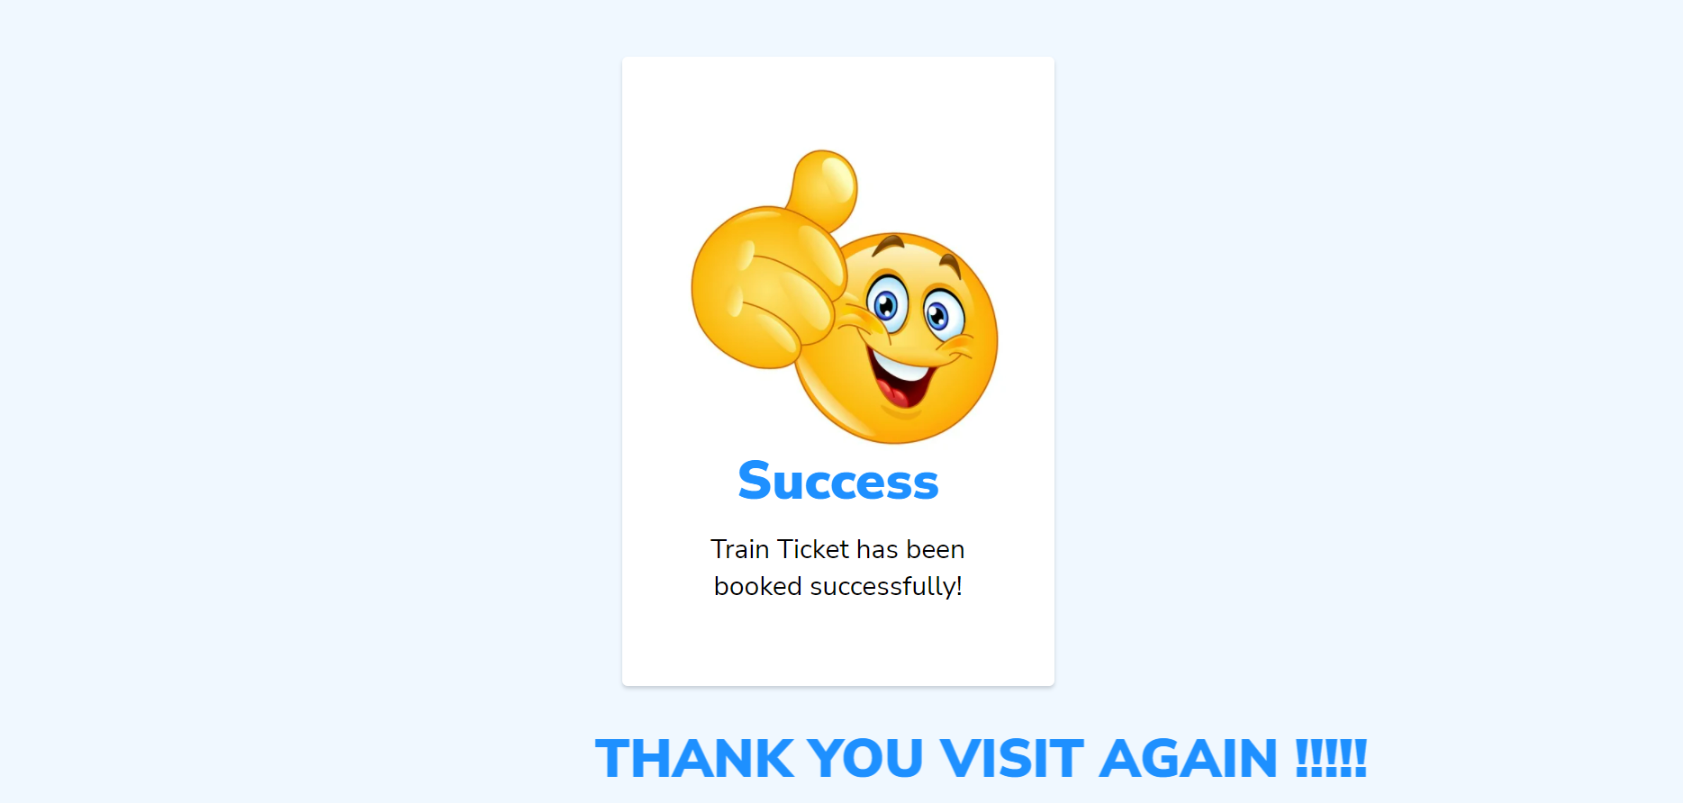

Slide 18
THANK YOU

